Slide 1


Summer project statistics team, ruakura
Mask R-CNN and Shiny app implementation to detect and classify hoof

Slide 2
objectives
Develop image processing techniques to automatically detect hoof conformation from photos
Build a Shiny App with summary outputs to give the farmer an overview of their animal health
Set up an initial working application first, subsequent and continuous improvement

Slide 3
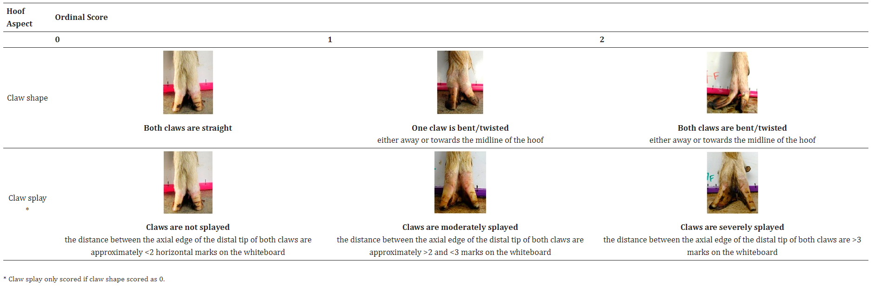
HOOF CONFORMATION in goats
Source : Deeming et al. paper

Slide 4
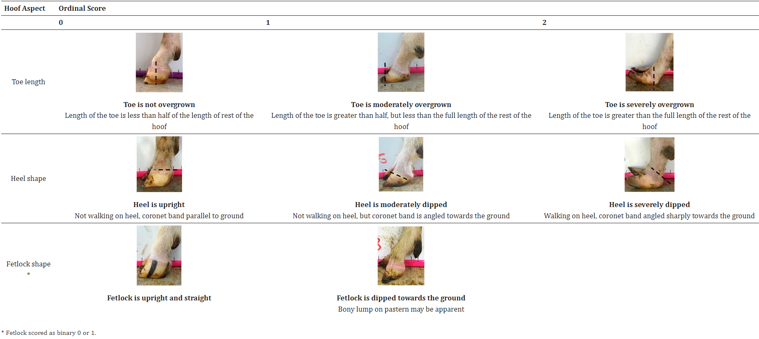

Slide 5
Approach to develop an image processing app to detect hoof deformity in goats
Training dataset - The hooves photographs used in Deeming et al. paper
Select a model – Mask R CNN
Set up the system and pipeline – NeSI
Annotate images – VGG Image Annotator
Validation and test dataset – Take approval and pictures
Train the model – Transfer learning
Evaluate the model – Mean Average Precision
Integrate the model with Shiny App – Reticulate package
Improve the model – image augmentation, class weights

Slide 6
Training dataset
Total image count | Dorsal aspect | Lateral aspect
343 | 178 | 165
Hoof aspect evaluated | Claw shape, Claw splay | Toe length or Growth, Heel shape, Fetlock shape

Slide 7
TOOLS and CONFIG
Task | Tool or Infra | Version/Config
Image labelling for training | VIA | Version 2
Model | Mask R CNN project on Github | TensorFlow 2
Training | NeSI | 4 CPUs, 128 GB RAM each, and a GPU (seven instances with 5GB each)
Visualise pipeline | Jupyter notebook NeSI
Integrate with Shiny App | Reticulate package in R

Slide 8
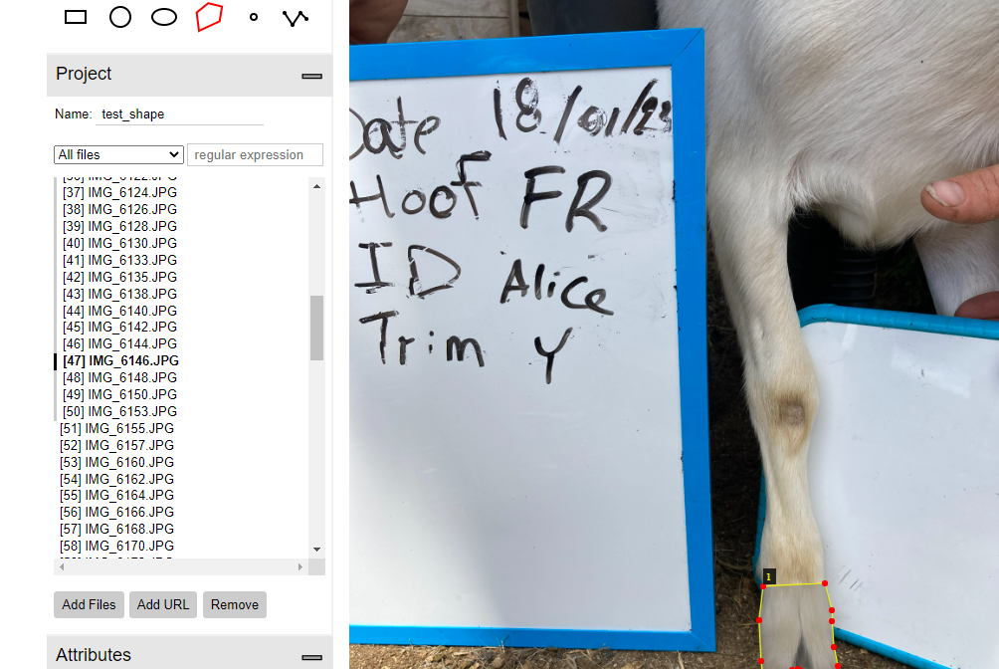
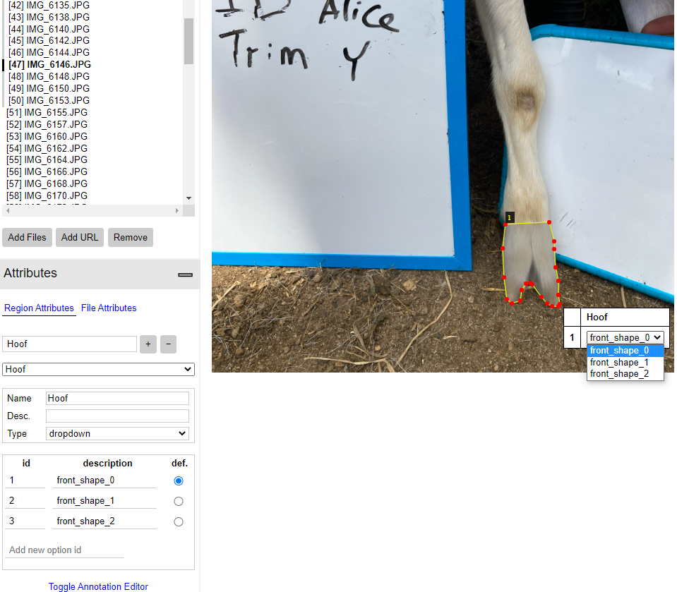
Annotate images

Slide 9
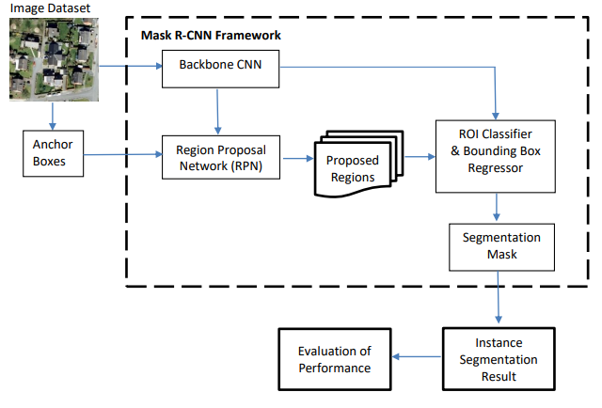
Mask RCNN
One of the high performing models and efficient method.
Simple to train and easy to generalize to other tasks.
Two stage framework:
Stage I - scans the image and generates proposals (areas likely to contain an object).
Stage II -classifies the proposals and generates bounding boxes and masks
Backbone – Feature extractor (low level and higher level)
RPN – Scans the image in a sliding window fashion and finds areas that contain objects (anchors are boxes distributed over the image area). Two output for each anchor – anchor class(FG/BG) and Bounding Box Refinement
ROI Classifier and Bounding Box Regressor – Runs in the regions of interest proposed by the RPN. Two outputs – Class and Bounding Box Refinement
Segmentation Mask

Slide 10
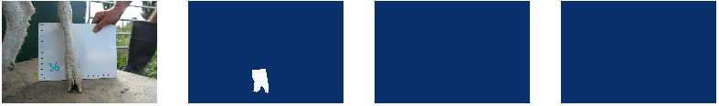
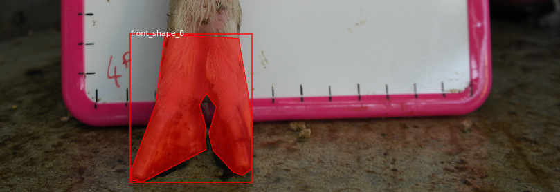
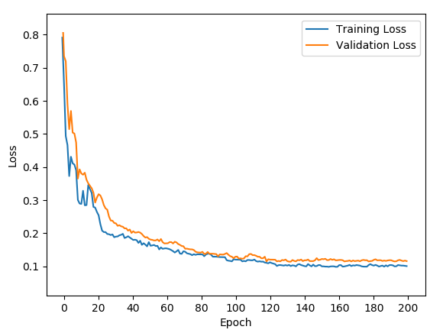
Training model
Import libraries
A Class was defined to load the dataset and annotations (JSON file), add masks and also read the number of classes according to our classification requirement
Dataset defined and loaded
Configuration for the model was defined that includes names of the configuration, number of steps per epoch, learning rate, number of classes, etc
Transfer learning was used (COCO dataset)– our training dataset is small, it saves time
Load initial model weights which are pre-trained weights using the COCO dataset.
As the transfer learning completes, the trained weight for our model is saved as an H5 file
Different values of batch size, learning rates, and epochs were tried out
Loss curve plotted manually

Slide 11
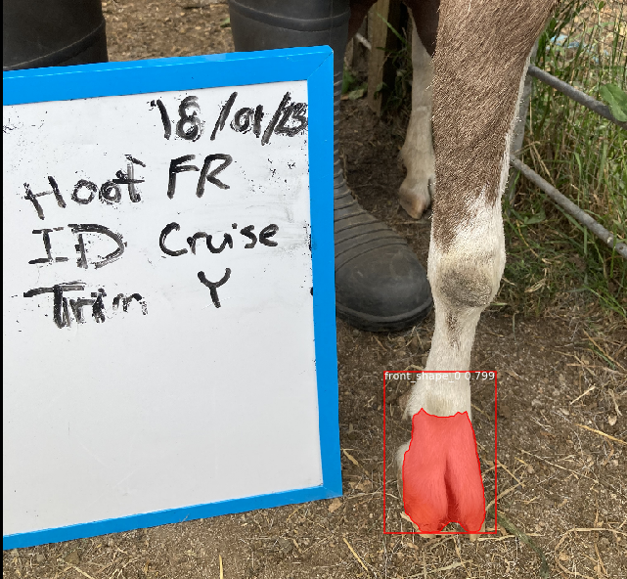
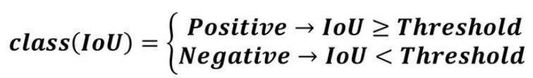
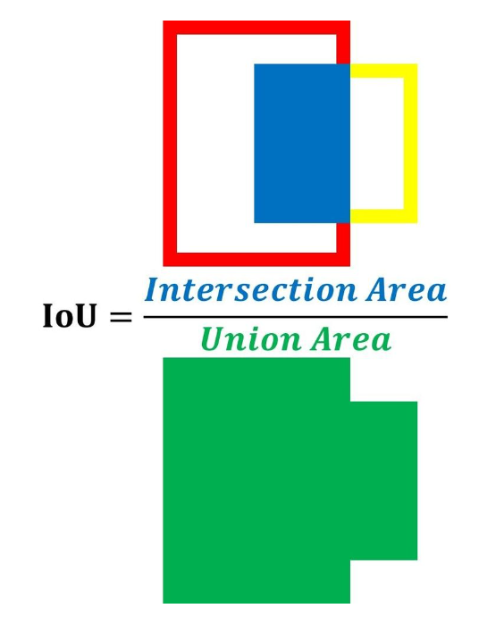
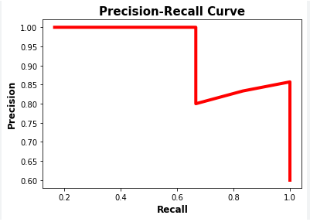
MODEL evaluation and Inference
Mean Average Precision
Inference was run for only one image at a time

Slide 12

Shiny app

Slide 13
results
Model for hoof aspect | mAP validation | mAP test | Detected on test | Accuracy on test
Claw shape | 0.4 | 0.43 | 51% | 85%
Claw splay | 0.73 | 0.72 | 97% | 85%
Toe length | 0.71 | 0.48 | 78% | 100%
Heel shape | 0.52 | 0.46 | 91% | 71%
Fetlock shape | 0.91 | 0.91 | 87% | 100%
*Class imbalance in validation and test dataset
*Values are for base model

Slide 14
Comments and next steps
Models can be improved by changing the training strategy, increasing the amount of training data, and further tuning the hyperparameters
Another factor that can improve the result is the placement of the camera while taking the hoof photographs
Surrounding conditions such as, whether the goat is standing on concrete or ground, shadows falling on the hoof, etc. also affected the result
Important to consider a balanced dataset or implement class weights while training the model

Slide 15
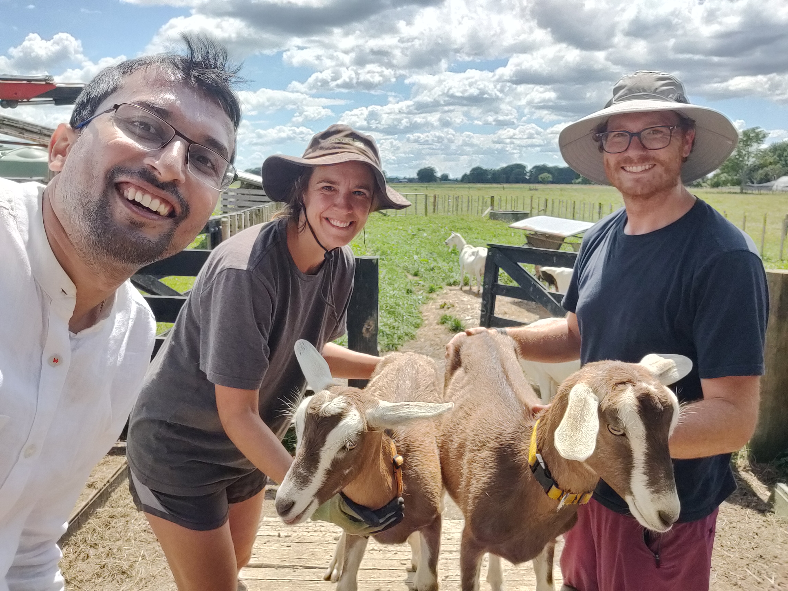
Thank You
Maryann Staincliffe
Dongwen luo
Gosia zobel
Kevan cote
Sam hitchman

